Slide 1
Evaluation
Partner Flight School
Notes:
In this lesson we discuss the concept of understanding and planning for customer consumption.

Slide 2
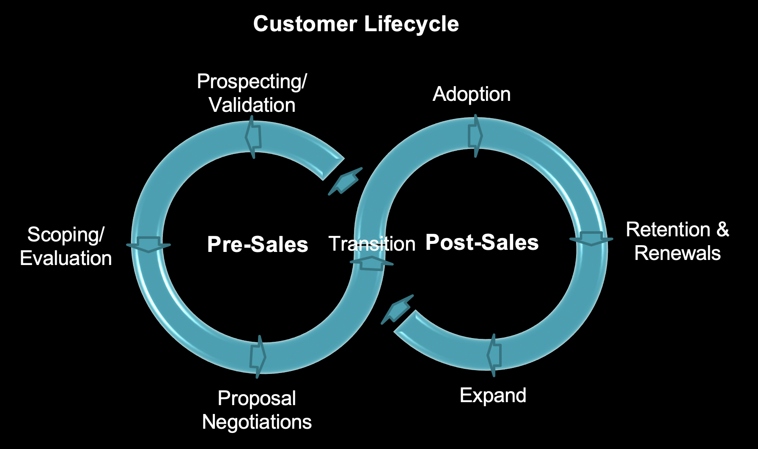
You are here!
Notes:
Here is the point we are concentrating on in this assignment.

Slide 3
Agenda
The Customer Lifecycle
Consumption Throughout the Customer Lifecycle
Gathering Consumption-Related Information
Presenting Consumption to the Customer
Transitioning Between Lifecycle Stages
Notes:
What is the lifecycle of customer consumption
How / when do I gather information from the customer to understand consumption
What tools are available to create a consumption plan
What is the relationship between historical, observed consumption and planned / hypothetical future consumption
How do I present the consumption plan to the customer
How do I transition the consumption plan to customer success

Slide 4
Why is Consumption Planning Important?
“Help me help you”
Consumption plans are used to forecast company performance and are extremely important for annual company planning
Influences how we divert resources and plan software improvements
DBUs vary based on Cloud Service Provider (CSP), type of VM being used, and what you’re doing with those systems (workloads)
Creates a positive, customer-obsessed experience
To answer the question:
“How much should I buy?”
...you need to estimate how many DBU’s the customer’s workload will require, and...
...better DBU Estimates help ensure a stronger, long-term partnership with your customer!
Notes:
[CLICK]
...in a way, this is our attempt of predicting the future. The challenge is to collect enough information during the sales cycle to be able to do this as accurately as possible.
[CLICK]
But be careful about just finding the workloads that consume the most DBU’s - remember, Databricks a value sell, so we want to go after the most valuable use-cases which aren’t always the ones that require the most compute.
[CLICK]
Remember - we can’t realize revenue until DBUs are consumed… which is why getting these estimates as correct as possible is so important!

Slide 5
Databricks Value to Customer
𝛼
Customer Value to Databricks
Growth
Widespread Adoption
SCP
Use Case Acceleration
Training
Upsell Opportunities
Adoption Phase
First Sales Experience
Discovery
Pay-as-you-go
Churn / Downsell Risks
time
Notes:
When we think of a given customer lifecycle:
(Golden Line)
[CLICK]
Over time they should be getting more value out of the platform. We want to maximize Databrick’s value to the customer, and the Customer’s value to Databricks.
There are number of different stages here in customer lifecycle:
[CLICK]
A. Discovery Phase – Initiated by customer, they have no exposure to DB Sales
[CLICK]
B. First Sales Experience – This is inflection point
Someone connects customer with sales rep.
There is an injection of expertise through the sales and pre-sales team.
Help is provided to onboard customer onto the platform.
Generally we see accelerated usage and value.
[CLICK]
C. Adoption Phase – After first commit.
Usually the trickiest phase of sales cycle. There is a hand-off from pre-sales to post-sales / Customer Success team.
Here we drive adoption by evangelizing Databricks in the account.
We try to grow influence in the account.
[CLICK]
D. Strategic Customer Program – This is another inflection point.
No pre-defined time for this occur
Customer is enrolled into SCP, or we decide to accelerate a few use cases jointly with customer, maybe we onboard them with some training.
We see increased value from the customer
[CLICK]
E. Growth – Widespread adoption
Generally there are cycles here
(Red Lines)
There are a bunch of opportunities throughout these phases in the account where we can encounter churn and down-sell risks.
[CLICK] [CLICK] [CLICK] [CLICK]
When we think about the customer lifecycle, we want to maximize customer value but we cannot do that if we have down-sell and churn risks.
[CLICK]
We want to minimize these.
Why customers churn at each stage?
C: First Sales Experience - They don’t have a great experience with the platform from the start.
Maybe they come from a single node data science background and they are struggling to migrate their existing workloads to DB.
D: Adoption Phase – Say we start off with strong value for a small data science team. That team grows and the organization has a shortfall of data engineers or more people
who know Spark. There could be some political issues in the account. There could be users who are implementing anti-patterns and that is having a negative
effect downstream with other users. We could lose out on having a Delta win if the organization decides to go with Snowflake (competitors).
(Blue Lines)
We also want to maximize any upsell opportunities in the account.
[CLICK] [CLICK] [CLICK]
Fundamentally, as we think about the customer lifecycle the questions is:
“How do we give as much confidence to what that customer lifecycle is going to look like so that we can build the right customer experience and then build our business in the right way so that we can use that information to make the right decisions”

Slide 6
Benefits of Consumption Planning
Maximize the customer lifetime value / experience
Identify churn / downsell risks
Product risks
Competitive threats
Organization / systemic risks
Identify upsell opportunities
Use case acquisition
Improve revenue forecast accuracy
Procure additional resources for your accounts
Notes:
There are several benefits that come with consumption planning.
Mazimize the customer lifetime value/experience – Better experience/value = more DBUs
We talked already about churn and down sell risks.
Upsell Opportunities - With Upsell it is about acquiring new use cases and capturing new influence or influencing new decisions, e.g. Strategic Architectural decisions.
Improve Revenue Forecast Accuracy – Really important because all of our customers have consumption trajectories, and we need to be able to accurately guess what our ARR is.
Procure Additional Resources – Identifying huge upsell opportunities that could, say double the size of the account, you can get additional resources to help you inside of the account. E.g. Through SCP program.

Slide 7
Consumption Planning in the Customer Lifecycle
Signed / Closed
Prospect / Validate / POC / Evaluation
Proposal / Negotiate & Procurement
Renewal / Upsell
Transition to Customer Success
Research + Discovery + Use-Case Validation + Technical Validation (POC)
DBU Estimation Worksheet + Continued Discovery + Use-Case Prioritization
Demand Capacity Worksheet + Services Scoping (SOW + Staffing Plans (Databricks + Customer)
Actual DBU Consumption + New Use-Cases
DBU Estimation Worksheet
Demand Capacity / Demand Mapping Worksheet
Consumption Plan
DBU Estimating + DBU Forecasting
Notes:
Let’s now talk about the different stages of consumption planning in the customer lifecycle.
The vertical line on the right is when a customer transitions from pre-sales to post-sales which means there is some type of committed deal.
Looking at what happens before the commit we have:
1. Pre-sales evaluation
2. We move into procurement phase
3. Transition to customer success (adoption phase) where we prepare for the next renewal or upsell opportunity.
(Blue Boxes)
Each of these has a bunch of different information that can be gathered at each stage of the customer lifecycle.
Box 1
[CLICK]
Generally speaking, when you are in evaluation stage there is an understanding on the customer side of what Databricks is
and also on the Databricks side about the customer’s business and how it operates.
E.g. What is valued by the business, what are their major objectives, etc.
This early research and discovery is important because it will help us identify where the right use cases are.
E.g. Are we working with the right groups? Should we be working with data engineering or focus on data science?
We then select the right use cases, the ones that are most interesting or most likely successful for us to go in and do a technical validation.
With this we can begin to estimate what workloads might come on to the platform. (DBU Estimation Worksheet)
Box 2
[CLICK] [CLICK]
When we have successfully shown the value in the tech validation (we’ve shown DB is the right tool) we move into the proposal and procurement phase.
Here we take the a priori use case information we gathered with the DBU estimate worksheet and translate that into demand and capacity worksheet (used by sales) to help with pricing.
Box 3
[CLICK] [CLICK]
We then do additional negotiations; we sign and close and then create the consumption plan.
It is a list of use cases and its basis is the estimation worksheet and then we maintain the plan well into the lifecycle of the customer journey.
Box 3
[CLICK][CLICK]
We use a combo of maintaining this consumption plus adding machine learning forecasts in the account based on observed usage to figure out what is the most confident future usage we can anticipate in an account.
When we move past commit stage, CSE’s and RSA’s are involved with the account day to day as they transition to post sales. They are talking to customers, understanding what the use cases are, logging them in Salesforce, logging monthly DBU’s. We use this information to figure out how to maximize that customer value throughout their lifecycle.
One of the most important parts of DBU estimation is getting the customer to own the analysis - if they know how you’ve estimated, what assumptions are being used, and the methodology along the way, they’ll be more likely to really buy into the numbers. When the customer really buys into what we’re proposing then things become much, much easier!

Slide 8
Why is Consumption Planning Tricky?
Lots of variables, and each customer environment is different
Streaming? Batch?
Machine Learning / Deep Learning
Number of users
Cluster size
Workloads
Complexity of the transformations
Number of jobs
Number of clusters
Data volumes / ingestion rates
Instance types
Notes:
Consumption planning is tricky and there are a bunch of reasons why.
[10 CLICKS]
[CLICK] [CLICK] [CLICK] [CLICK] [CLICK]
All this info is going to be used in order to determine how many DBUs a single given workload will require in an account.
[CLICK] [CLICK] [CLICK] [CLICK] [CLICK]
E.g. Single automated job:
1. How much data is it going to process, 50GB, 1TB, 10TB?
2. What types of clusters are needed, what types of instances, what is the size
3. GPU’s vs. CPU’s
4. How many concurrent user are going to connect to the cluster. If this is a job then probably 1, if it is an interactive workload then it could be 100’s
All these things are going to effect what a given workload might cost, in terms of VM cost from the cloud provider and DBU consumption.
If you have all these data, then you can make a reasonable and somewhat accurate estimate of what a job is going to cost.
[CLICK]
TRANSITION TO NEXT SLIDE “LACK OF INFORMATION”

Slide 9
Lack of Information
and Influence are the Biggest Factors
Gathering a priori information from the customer and influencing decisions in the account has the biggest impact on long-term consumption
Notes:
[CLICK]
The more influence you have in an account the more likely it is that you have access to the right people to get the information needed to better estimate consumption both on current and future workloads.
When you think about how this is achieved there are a bunch of factors and techniques to help build those relationships.

Slide 10
Information Gathering Techniques
Notes:
Ok, now let’s walk you through how you’d do this in practice, using a real template that our SA’s use in the Field….

Slide 11
Cultivate relationships and influence
Develop trust; become an advisor
Prove technical value
Align with architectural decision makers
Align with business leaders
Notes:
The biggest thing you can do is to establish trust in an account and show technical value. We all have technical expertise, and our customers want to use that.
We can use that to create powerful relationships and align to key decision makers within the business (budget holders) as well as architectural decision makers.
E.g. If you have a close relationship with your customer, they may tell you that they are evaluating a competitor which is very good information to have and you are now in a great position to act on that information.
Trust takes time!

Slide 12
Understand the business model
What is the AI / data strategy for the business?
What is the relationship between cost and profit centers?
How are your customers evaluated? What happens if they fail?
What are the major / minor company initiatives and how does Databricks fit into them?
Notes:
Understanding the business model is related to trust and relationships. If you don’t understand how a business operates, then it is going to seem shallow to the customer.

Slide 13
Ask questions
Can you help me understand how market manipulation works?
How do you use data and ai to find bad actors in a financial market?
How does this project fit into your team’s goals for the year?
Notes:
Probably the trickiest part of the process is asking questions. Asking the difficult/right questions is just going to help the customers and Databricks.
We are all about maximizing that customer value they get out of Databricks and the value Databricks get out of the customer.
So, if we are not aligned from a partnership perspective then you need to fix that. The way to understand if there is a misalignment is to ask questions to better understand their business.

Slide 14
Value of Information Gathered
Databricks Value to Customer
𝛼
Customer Value to Databricks
Growth
Widespread Adoption
SCP
Use Case Acceleration
Training
Information is gathered throughout the entire customer lifecycle
Adoption Phase
First Sales Experience
Discovery
Pay-as-you-go
time
Notes:
(Gold Curve)
[CLICK] [CLICK]
Coming back to the customer Lifecyle and looking at the vertical access, the value of the information we gather increases as we get further into the customer’s lifecycle.
(Red Line)
[CLICK]
And we must gather that information throughout the entire lifecycle.
And this is the responsibility of the entire account team, through the entire lifecycle.

Slide 15
Responsibilities by Role
When it comes to consumption planning, everyone has a part to play
Account Executive
Solution Architect
Customer
CSE
Discover use-cases, and tie to Key Stakeholders
Quantify total solution value
Use-case priorities
Convert consumption estimates to total Demand Capacity
Ultimately responsible for consumption (cloud costs too!) If they know where the numbers came from, they will own it, and they will defend it!
Gather technical demand info during sales stages
Develop and validate use case consumption estimates alongside customer
Maintain up-to-date Consumption Plan
Comparing forecasted and actual values, and alert as needed
Notes:
So we have a few different responsibilities by role here at Databricks and there must be a unified strategy for what types of information they go after and the approach they take.
E.g. The SA does not go it alone, he/she must align with the AE to figure out what information they need.
Ultimately, customers own responsibility for consumption costs. But it is our responsibility to include them in the planning and help them to understand how we settled on the plan.
Having a great relationship makes this much easier.

Slide 16
DBU Estimating
Three-Phased Approach
1. T-Shirt Sizing / Info Gathering
2. Technically Tested Demand
3. Total Demand Estimate
Based on early information data & discovery
Rough estimate (wide error bars) commonly used to determine whether to pursue an opportunity
Generally not shared with client
Detailed templates provide more accurate estimates than T-Shirt method
Use technical methods (e.g. POC’s) to validate info gathered in Phase 1 and develop higher-confidence DBU Estimates
Empirically-derived numbers
Includes Technically Tested Demand estimates PLUS DBUs associated with future use-cases that haven’t been technically validated
Notes:
T-Shirt sizing - be careful here, you don’t necessarily want to qualify out an opportunity because it’s low DBU. It might be a massively important use-case for the customer with huge value that unlocks many other use-cases down the road. Of course, the opposite might be true - high DBUs doesn’t necessarily mean high value.
Types of questions to ask:
I'd break this down into some basic early questions like number of users, size of data lake, how much data is ingested, how many nodes of X, what types of nodes, how often jobs run to get this data, etc. We should do this in a way without seeming like we just sizing up the opportunity.
Note again we’re assuming no prior Databricks usage here - not even Pay as you go (PAYGO)

Slide 17
DBU Estimating - Phase 1
1
T-Shirt Sizing
Description | Initial estimation at projected consumption for a customer based on limited available data to decide if it’s a “small, medium, large, extra-large environment” Limited data might include early use-case info, number of users or jobs, and data volumes
Sales Stages | Discovery, Validation
Level of Effort | LOW
Accuracy | LOW
Other Notes | “If someone walks into a Ferrari dealership with $50 to their name, they may not be a hot lead.” Typically not shared with customers directly, but used to qualify in (or out) an opportunity Be sure to consider business value too!
Notes:
The first step in the demand planning process is the initial t-shirt sizing. This should be done by the SA early in the sales process, usually during the “Discovery” and “Validation” sales stages.
The t-shirt sizing is the initial estimation at projected consumption for a customer based only on a few data points such as use cases, number of users/jobs and data volumes. The inputs needed for the t-shirt sizing are typically done organically by the SA and AE as they gather information from the discovery and qualification process.
This t-shirt estimation has high error bars and is typically not to be shared with the customer. However it is critical for the internal sales process to:
Understand the potential size of the deal for forecasting
Help decide the level of effort and resources that should be invested for the technical validation.
Qualify that the size of the workload aligns with the customer's budget and business value.
During this phase the SA and AE should be working together to find the highest value workloads to the customer that also align to significant DBU consumption. Typically in this stage an SA and AE will qualify the opportunity in or out based on the t-shirt sizing and other qualification questions.
If the opportunity is qualified and the t-shirt sizing aligns with the customers business value, budget, and the technical validation level of effort, then the opportunity typically move to the next stage.

Slide 18
DBU Estimating - Phase 2
2
Technically Tested Demand
Description | Using technical means to provide higher confidence levels to initial DBU estimates; likely includes a POC, or a technical validation (e.g. profiling existing workloads on customers’ current solution)
Sales Stages | POC Scoping, Evaluation
Level of Effort | MEDIUM to HIGH
Accuracy | HIGH
Other Notes | Try to find the highest value use-cases to prove out to the customer Analogous estimating is another method to consider instead of a full-fledged POC (which are time-consuming, and may delay your deal)
Notes:
The second step in the process is to work on the technically tested demand estimate. This is done by the customer and the SA during the technical validation phase. This step is not only about sizing the workloads but about selling the customer’s teams on the fact that Databricks is the best platform for their workloads. However along the way the SA and the customer usually gather enough data points to produce an accurate estimate.
This step takes one to a handful of workloads and tests them on Databricks. Typically we try to test the workloads that have both the biggest impact on consumption (high DBUs) as well as highest value to the customer, this ensures that we are working on a project that is both good for Databricks and for the customer. Ideally this test would be done with a sample of production data but can also be done using synthetic data in some cases.
This step helps provide more accurate and useful baseline DBU estimations that could be extrapolated to cover a broad set of use cases. This step also helps get buy-in from the customers that demand plans that are accurate.

Slide 19
DBU Estimating - Phase 3
3
Total Demand Estimate
Description | The inclusion of future (possibly unscoped, likely untested) workloads into your customer proposal - in addition to the technically tested and validated estimates for known workloads
Sales Stages | Proposal, Negotiate & Procurement
Level of Effort | MEDIUM
Accuracy | MEDIUM to HIGH
Other Notes | Note that your accuracy may actually decrease between Phase 2 and 3 because you’re including possibly untested workloads in your final proposal Ensuring your customer owns and believes the estimates is the most critical thing
Notes:
The final step is building the total demand estimate based on all the use-cases for the initial opportunity PLUS valuable use-cases the customer would like to implement with Databricks in the future.
Once the POC or pilot is complete there is a baseline that can be used to help calculate the overall DBU numbers. Depending on the customer and whether you’re creating a proposal for a specific business unit, small customer, or multiple business units across a large enterprise, you could use any of these approaches to come up with the sizing for all the “use cases” (used loosely - it could mean anything from a single-node workload to a set of 50+ different streaming workloads being implemented by Data Engineering team).
It is important to include the technical teams from the customer in this phase of the demand forecasting because their sign off is critical. Once this phase is done the AEs will move toward building a proposal and business value deck for the champion and economic buyers at the account. Often the economic buyers go directly to the technical teams to ensure that the proposal sizing numbers are accurate. It is the SAs jobs to ensure that the technical champion validates these demand forecast.

Slide 20
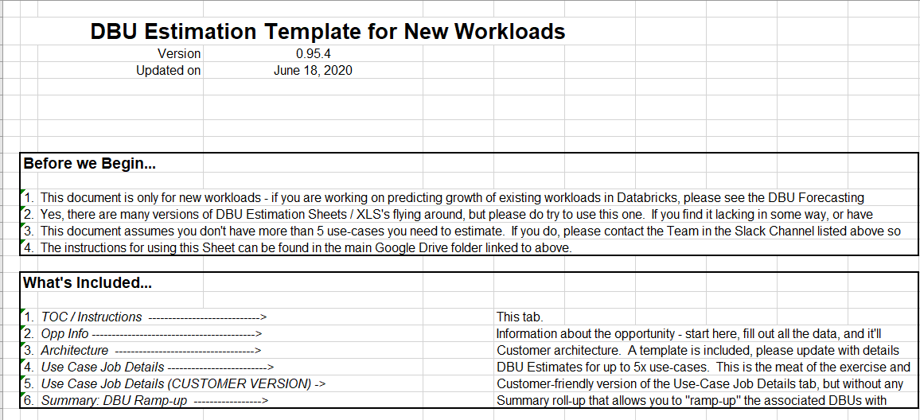
DBU Estimating Template
Notes:
This is our estimate template.
All the instructions are provided in the template so that you can fill it out to produce an estimate of DBU usage.
Go to Workramp and pull up the template.

Slide 21
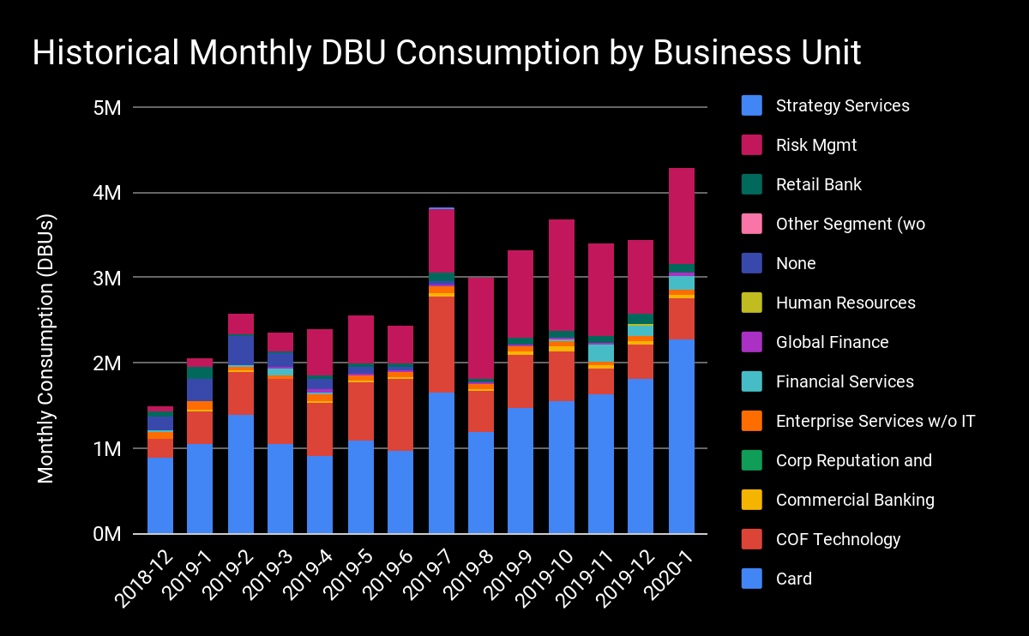
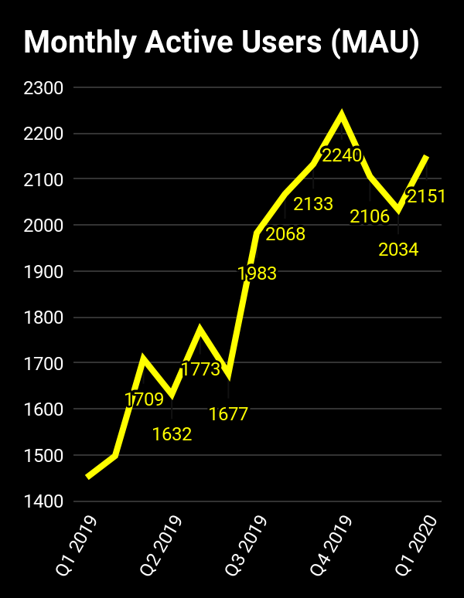
Databricks Growth at Customer
4x Annual DBU Usage Annual Growth
3x Monthly Active User Annual Growth
Notes:
How you present consumption plans to a customer is important.
You just don’t want to present a spreadsheet, the customer could get lost in a sea of numbers.
There needs to be a strategy.
You need to think about the customer’s concerns and how do I present this information to them in a way that communicates the right message to the customer.
E.g. Here we see annual 4x growth of DBU consumption as well as significant increase in active users' growth. This says that Databricks is becoming very popular within the customer.

Slide 22
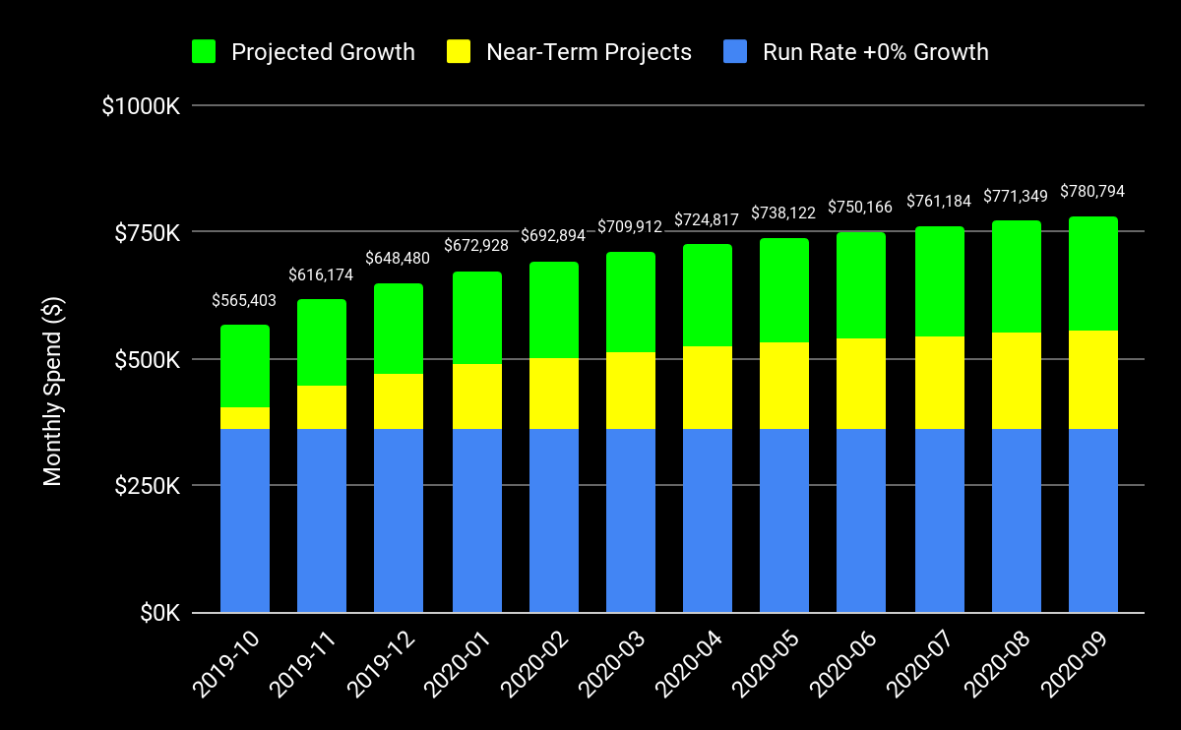
Forecasted Monthly Spend
Option 3: $9.7M
Option 2: $7.8M
Option 1: $5.7M
Notes:
This is an example of how we would present usage to a customer in a proposal.
Say we have a sales motion where we have different scenarios where we are getting different customers to buy different quantities of Databricks this might be how we present it to the customer.
==========================================================================================
Assumptions
Month-over-month growth averaged 19.58% between May, June, and July 2019 and 12.91% between February to July 2019
September 2019 monthly spend equal to average spend of May, June, and July 2019 adjusted with 6% growth factor
Separate operational production environment provisioned in January 2020 for Gold Resilient workloads
Estimate portion of new Delta Lake workloads added each month
Estimate portion of new operational production workloads added each month
8% of existing automated workloads are moved monthly from the Enterprise shard into the Operational Production environment or converted into a Delta Lake workload

